Slide 1
ONLINE LITERARY MANAGEMENT SYSTEM
By:
Sujal Bajracharya
Balram Magar

Slide 2
INTRODUCTION
Captivating Stories Everywhere:
Lost in a Sea of Pages?:
Navigating Your Literary Journey:
Empowering Readers:
Built for Everyone:

Slide 3
PROBLEM STATEMENT
Too Many Reads, Not Enough Order:
Tech-Savvy Only?:
Missing the Mark:
Our Solution:

Slide 4
OBJECTIVES
Effortless Exploration:
Read, Write, Organize, Repeat:
Make it Your Own: One System, Any Story:

Slide 5
METHODOLOGY
Progressive Build:
Adaptable to Change:
Proactive Risk Mitigation:
Early User Involvement:

Slide 6
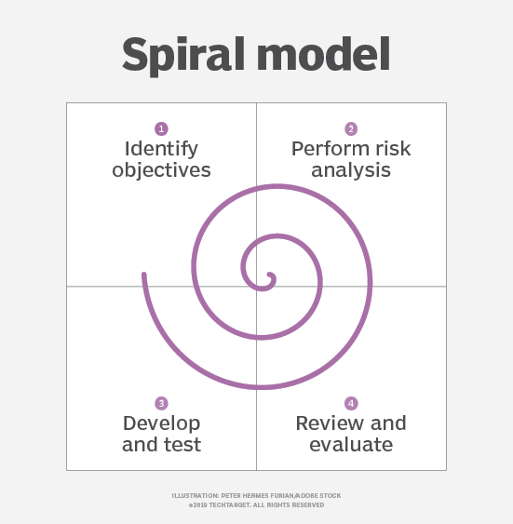
SYSTEM DEVELOPMENT ACTIVITIES
Spiral Improvement:
Prototype Powered:
User-Driven Design:

Slide 7
Requirement Identification
Learning from Existing Systems:
Listening to User Needs:

Slide 8
Feasibility Study
Technical Viability:
Operational Sustainability:
Economic Value:

Slide 9
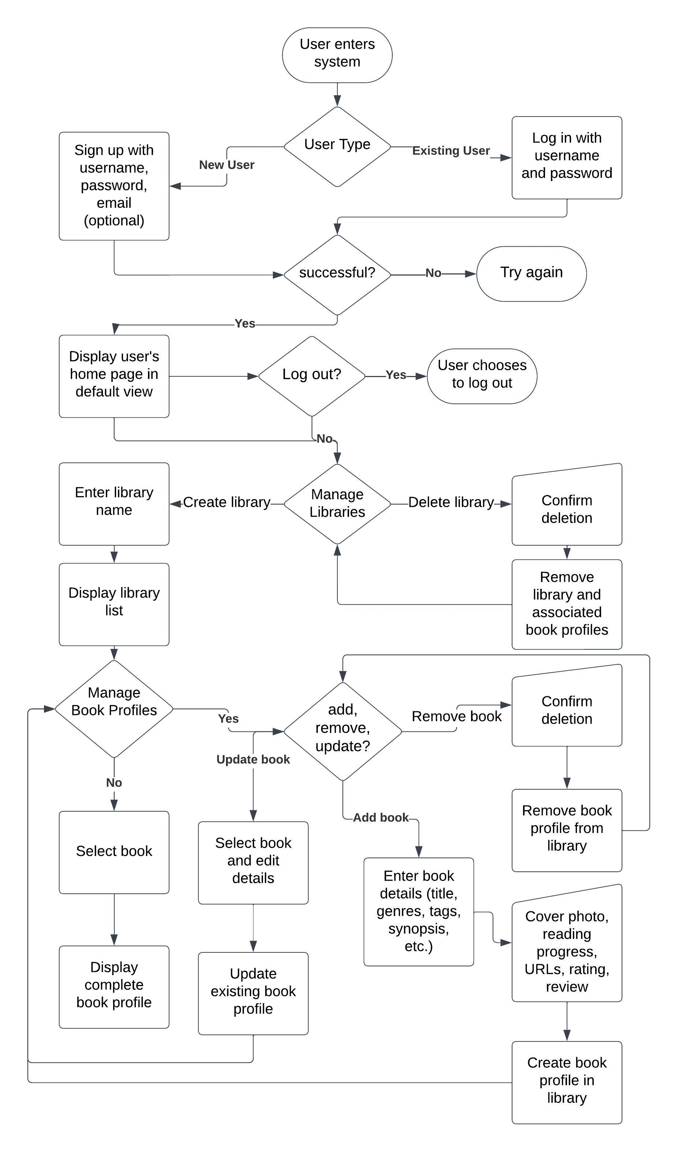
High-Level Design of System
System Flow Chart

Slide 10
Methodology of the Proposed System
Responsive & User-Friendly:
Secure & Efficient Back-End:
Centralized Data:
Privacy Focus:

Slide 11
Working Mechanism of the Proposed System
Effortless Exploration:
Personalization:
Multiple Libraries:
Detailed Book Profiles:
Full Control: Create, read, update, and delete book profiles at will.

Slide 12
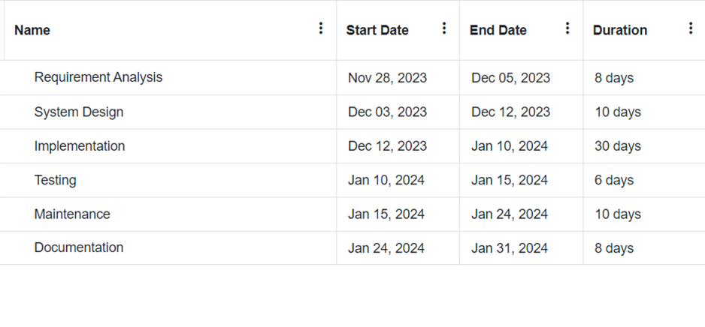
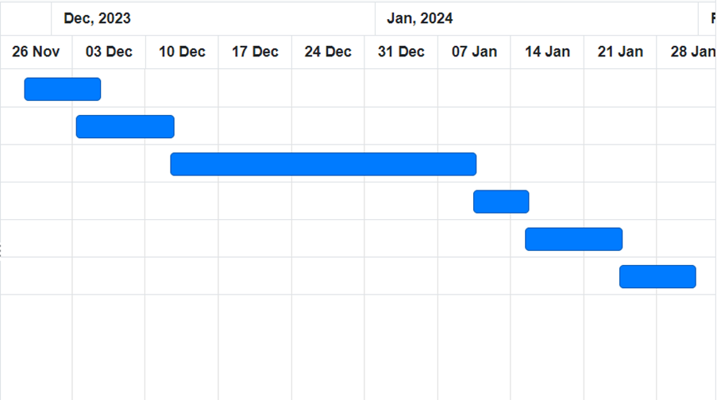
GANTT CHART

Slide 13
EXPECTED OUTCOME
Personalized library management.
Literary content within personal collections.
Creating a user-centric and functionally rich system.

Slide 14
REFERENCES
 | [1] | T. Contributor, "What is Spiral Model and How is it used?," Tech Target, August 2019. [Online]. Available: https://www.techtarget.com/searchsoftwarequality/definition/spiral-model. [Accessed 15 December 2023].
 | [2] | "Free Online Gantt Chart Software," ONLINEGANTT, [Online]. Available: https://www.onlinegantt.com/#/gantt.

Slide 15
THANK YOU
Any Questions?
By:
Sujal Bajracharya
Balram Magar

